Slide 1
The Last Bank in Town
The Future of Banking in Rural North Carolina
February 16, 2017

Slide 4
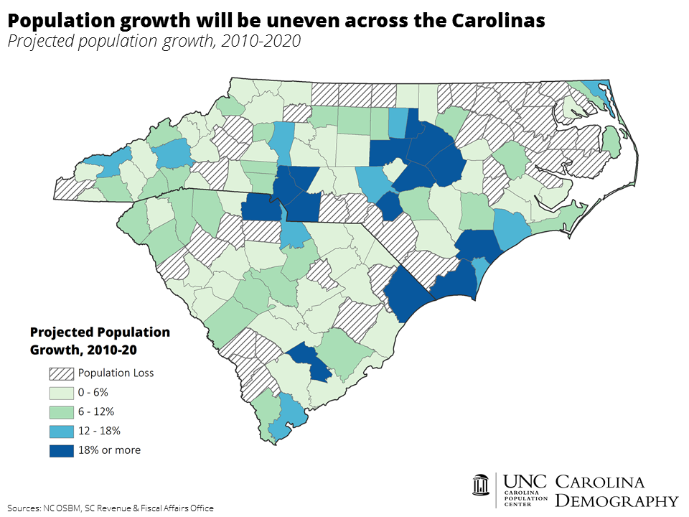

Slide 5
Impacts
Cash and credit deserts
Decline in business lending – 8% decline for several years after closing
Vacant building – blight and diminished community confidence

Slide 6
NC Counties at Risk of Becoming Banking Deserts
County | Existing Branches | Risk Factors
Northampton | 1 | Population loss, low average deposits, low median HH income, recent branch closures
Tyrrell | 2 | Population loss, low average deposits, low median HH income
Gates | 2 | Population loss, low average deposits
Warren | 2 | Population loss, low median HH income
Caswell | 2 | Population loss, low average deposits
Jones | 2 | Low average deposits
Bertie | 3 | Population loss, low median HH income, recent branch closures, national bank with low deposits
Washington | 4 | Population loss, low average deposits, low median HH income, recent branch closures
Anson | 5 | Population loss, low median HH income, recent branch closures, national bank

Slide 7
NC Counties at Risk for Branch Closings
County | Existing Branches | Risk Factors
Richmond | 12 | Population loss, low average deposits, low median HH income, recent branch closures
Edgecombe | 10 | Population loss, low average deposits, low median HH income, recent branch closures
Bladen | 8 | Population loss, low average deposits, low median HH income
Montgomery | 9 | Population loss, low average deposits, recent branch closures
Stokes | 9 | Low average deposits, population loss, recent branch closures
Columbus | 14 | Population loss, low median HH income, recent branch closures
Halifax | 19 | Population loss, low average deposits, low median HH income

Slide 8
Technology / FinTech
Migration to online and mobile banking
Greater competition, increased efficiency, faster payments, innovation
But, limitations in the role of technology
Tend to be thin
Lack of consumer protections
Rural areas have less access
Complement not replace bank branches

Slide 9
New York State Banking Development District (BDD)
Encourage the establishment of bank branches in areas across NY state where there is demonstrated need for banking services
Banks apply with local government for designation of a BDD area
State of NY deposits $10 million in subsidized deposits
Initial deposit is 4 years – no limitation on renewal requests
Can also request that the State Comptroller deposit non-subsidized, market rate deposits in the amount of $25 million for 5 years
42 approved BDDs, the majority in urban areas – 6 in rural areas
Opportunity for a similar program in NC designed to support rural branches?

Slide 10
Credit Unions
595 credit union branches throughout North Carolina
At least one credit union branch in every NC county
Federal Credit Union Act – allows a multiple common bond federal credit union to include “underserved areas” in its field of membership without regard to location
Local community, neighborhood, or rural district
Designated an “investment area” by CDFI Fund
Underserved by other depository institutions

Slide 11
CFPB has identified 29 NC counties as rural and underserved

Slide 12
Recommendations
More interagency cooperation and sharing of data
More emphasis on community impact at the branch level when considering a closing

