Slide 1


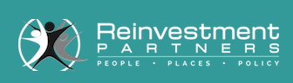

BRANCH TRANSFORMATION
NCR solutions and services delivering disruptive change to FIs revenue models and physical network distribution
February 16, 2017
Tim Quinn
Branch Transformation Specialist
Notes:
Presenter Guidance Notes
The title says it all – this is no longer about just singular branch transformation – NCR can help change networks

Slide 2

Industry Transformation
Last 5 – 10 Years
Next 5 – 7 Years
Better customer experience across all channels
Customer driven banking – appointments, access to specialists
Leverage data to have “personal” relationship with clients
Role of branch to develop relationships
Staff are financial advisors
Convenience remains number one driver of why customers choose their bank
Will lead to ……..
Focus on revenue growth from acquisition and cross-sell activities
Repositioning branches to smaller footprint / lower cost locations
More locations to maximize access
Customer adoption of mobile banking
Reduced teller transactions at branches
Low interest rate environment
Led to ………
Staff reductions
Reduced hours
Branch consolidations
Industry consolidation
Move towards universal bankers
Branch purpose to sell vs. transact
The Survivors

Slide 3
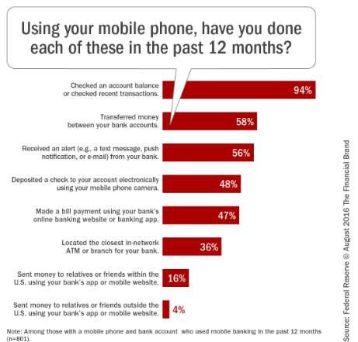
Growth of Mobile Banking Uncertain
53% of consumers with smartphone and bank accounts use mobile banking – up 1% from 2015.
There is still a significant proportion of consumers who have no desire to use mobile banking or make mobile payments in the near future.
Reasons vary – satisfied with current way of banking to not feeling mobile channels secure.

Slide 4

Industry News – 3Q ‘16
Community Bank Performance – Highlights
5,421 Community banks (3Q ‘16)
3Q ‘16 Highlights …..
Full year 2015 earnings of $20.4B, up 9.7% over 2014
3Q 2016 earnings $5.6B, up 12% YoY
Loan and lease balances up 9.4%
Higher net + non interest income (8.5%) offset by increased provisions and non-interest expense
3Q operating expenses increased 6.4%
  Higher salary and employee benefits
Non interest expense 65.8% of net-operating revenue, the lowest level since 3Q 2007

Slide 5
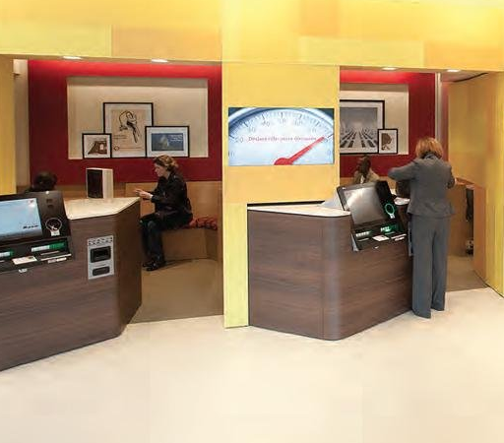
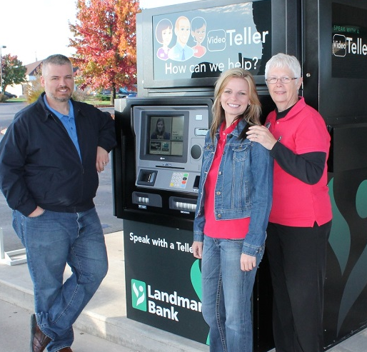
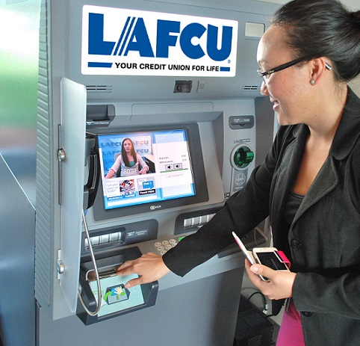
Branch Transformation
When branch is open, when closed, as branch alternative
Cash check – customer
Cash check w/ deposit – customer
Pay loan/mortgage – using cash or/and check
Pay bill – using cash or/and check
Withdrawal on line of credit (no card present)
Deposit to account (not own)
Business deposit
Special account dep/withdrawal (eg Xmas acct)
Withdrawal over limit
Withdrawal set denomination
Card not present transaction

Slide 6
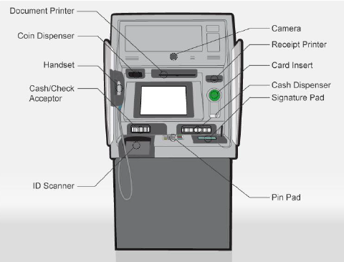
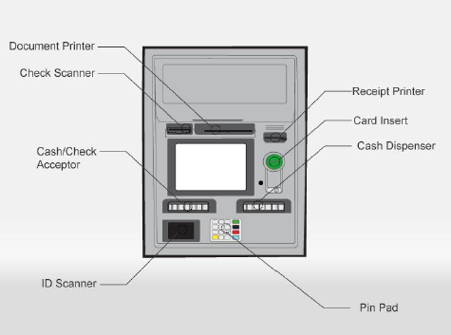
NCR Interactive Teller – Overview
Self Serve 32 Walk Up
Self Serve 34 Drive Up

Slide 7
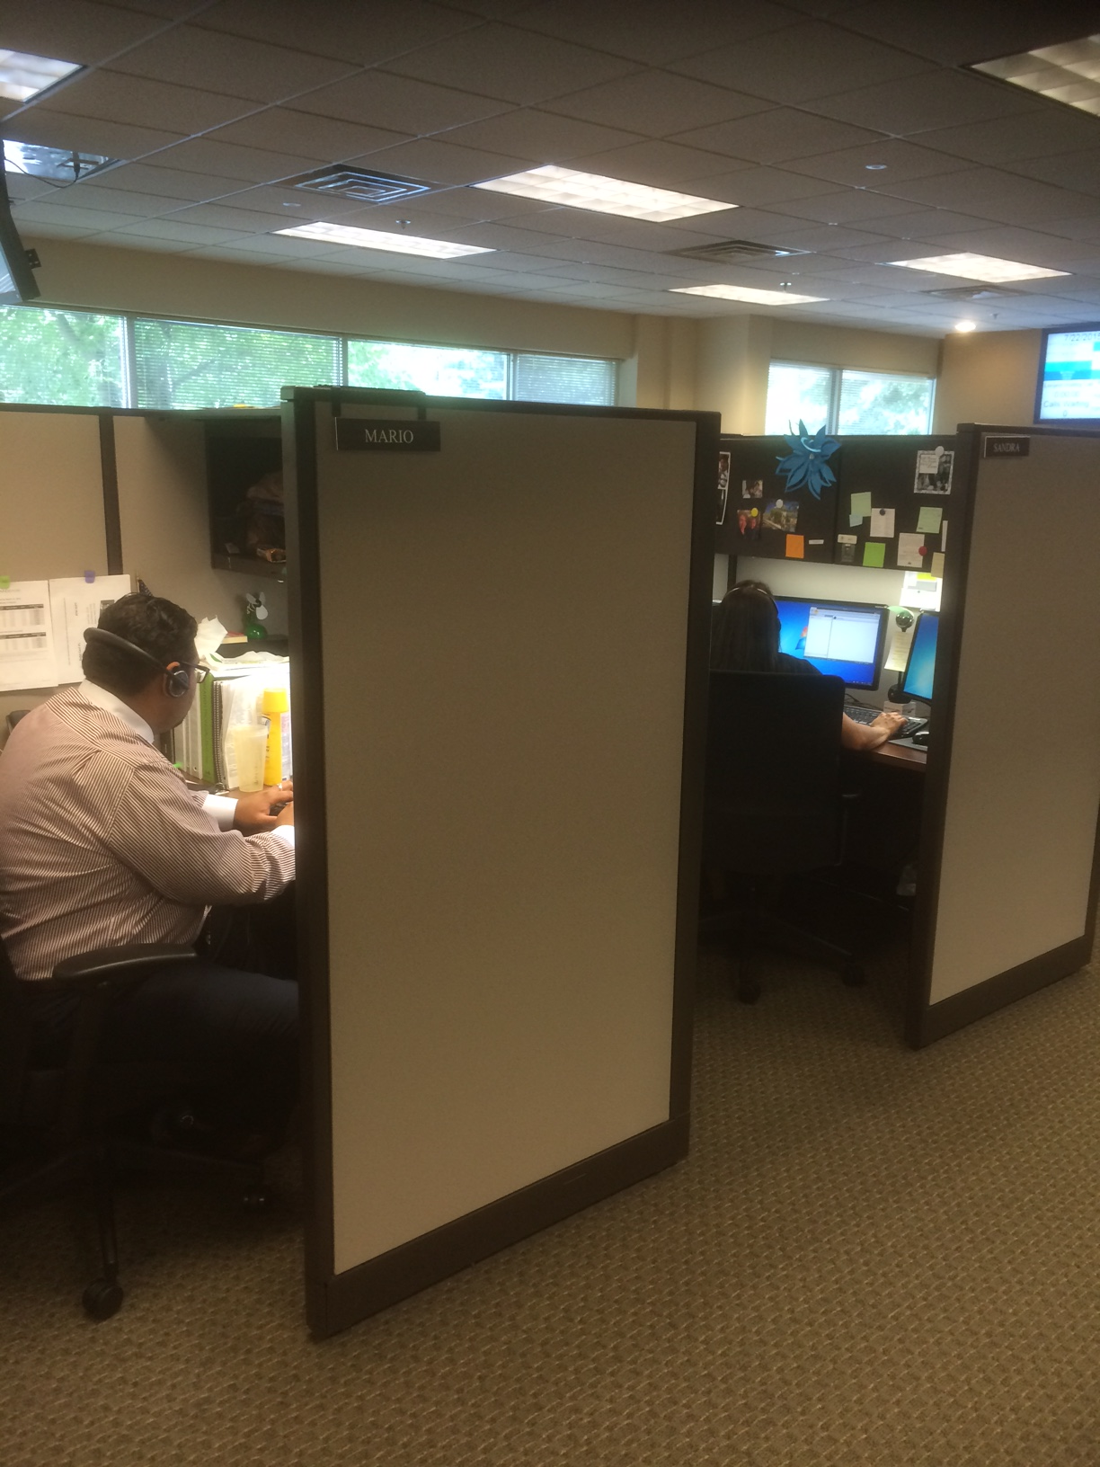
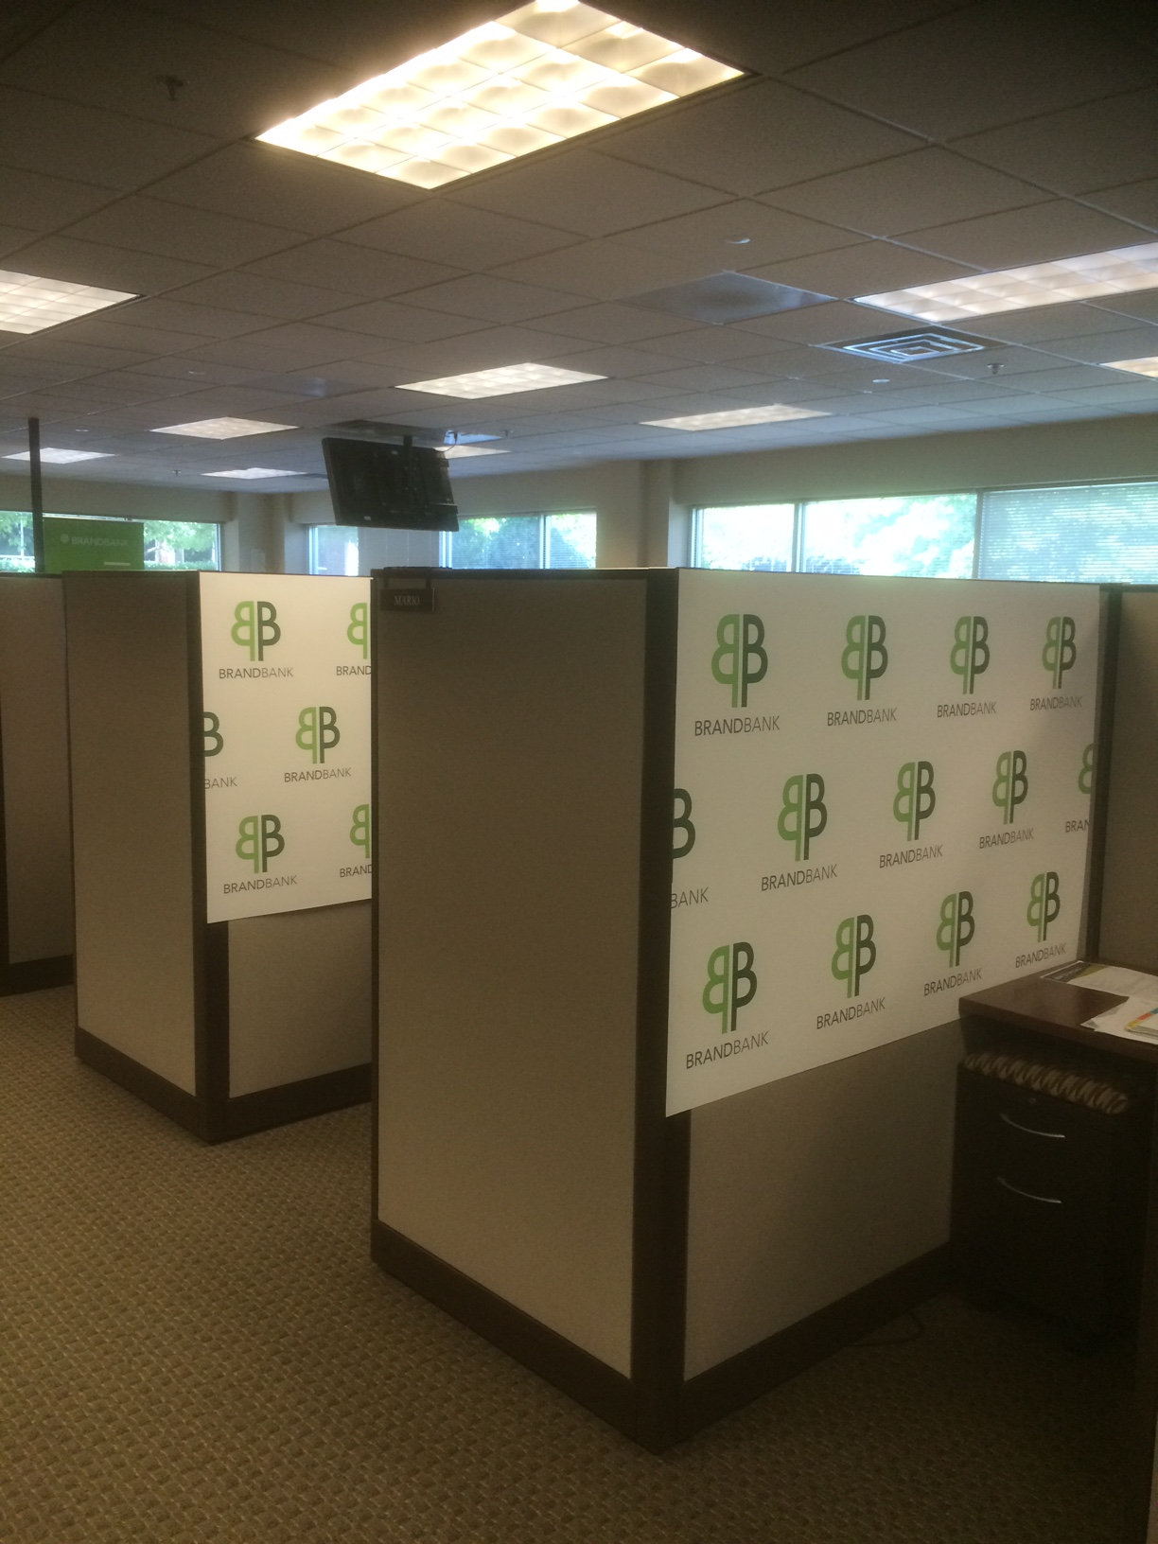
Central Teller Work Station

Slide 8
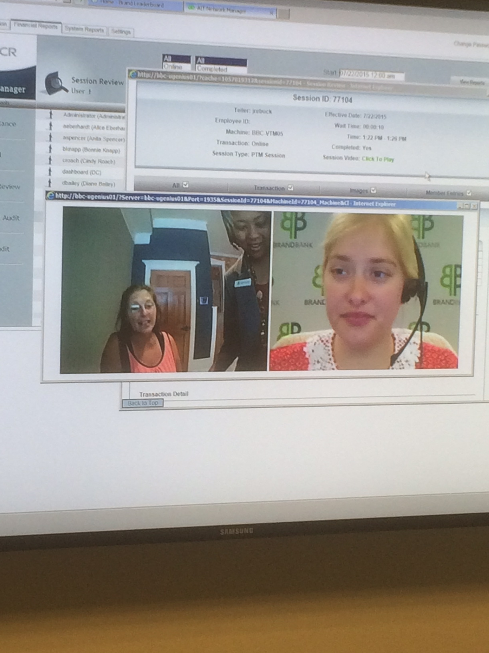
Centralized Teller Servicing
Teller View
Customer View

Slide 9
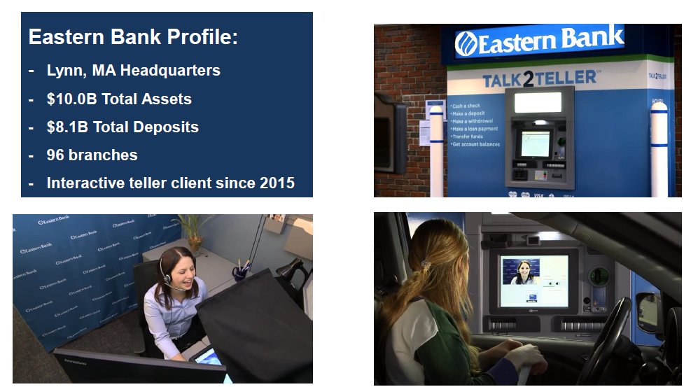
Eastern Bank Video

Slide 10
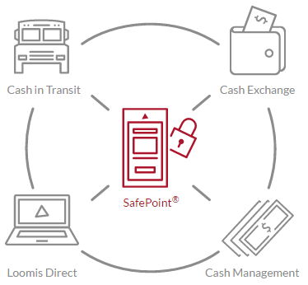
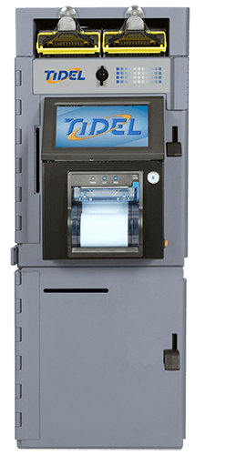
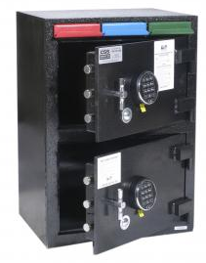

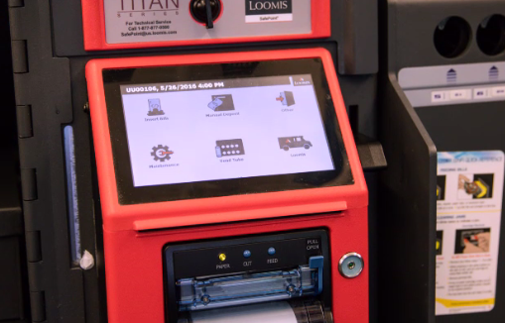
Small Business Cash Intensive Solutions – Drop Safes
Cash management and armored transit offer drop safe solutions for high volume cash businesses.
Conditional credit provided for deposits to small businesses.
CIT providers settle deposits and confirm credit for banks based on agreed upon schedule.

Slide 11
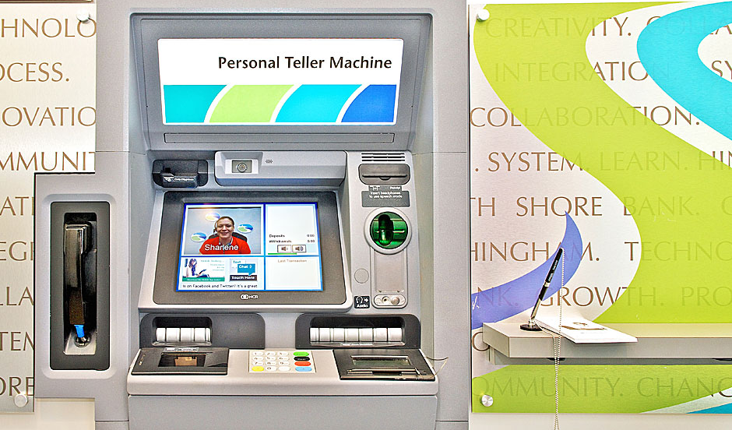
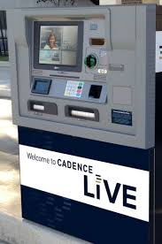
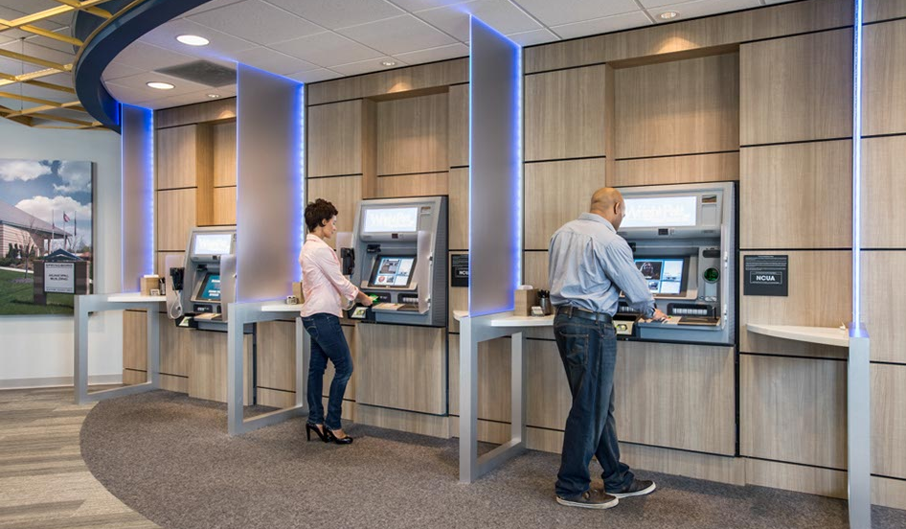
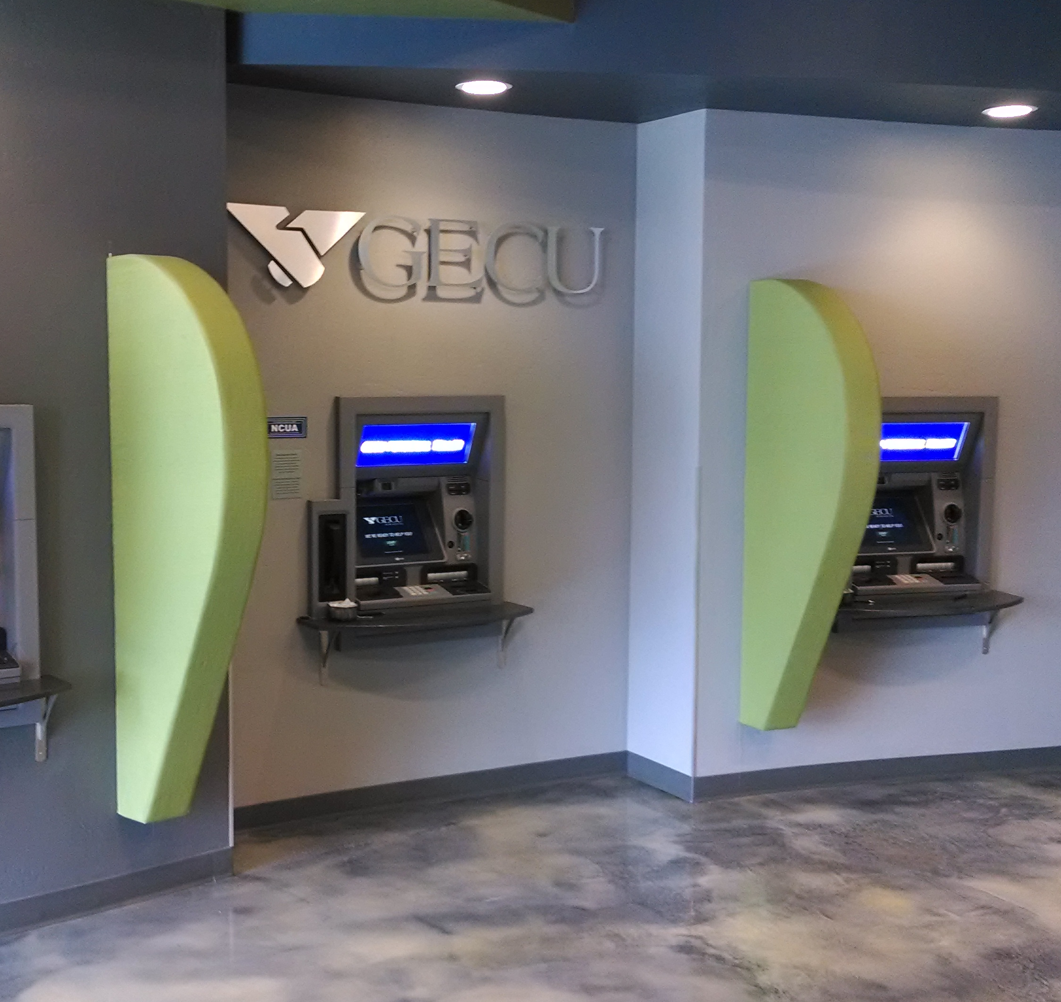
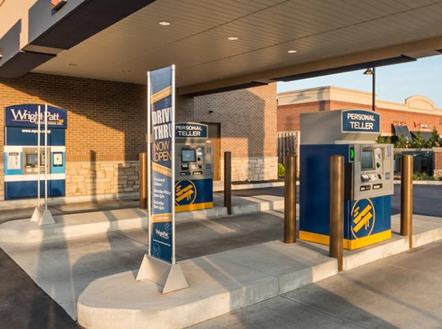
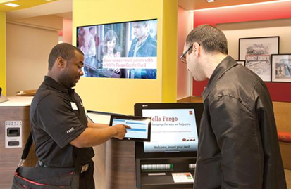
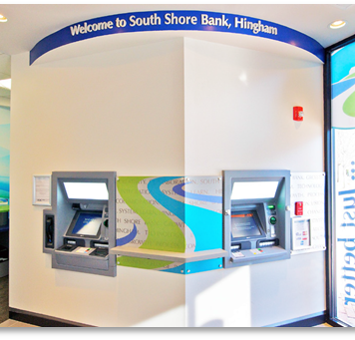
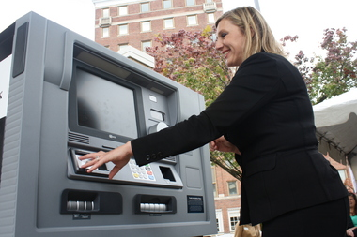
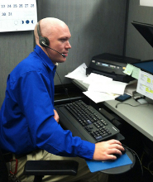
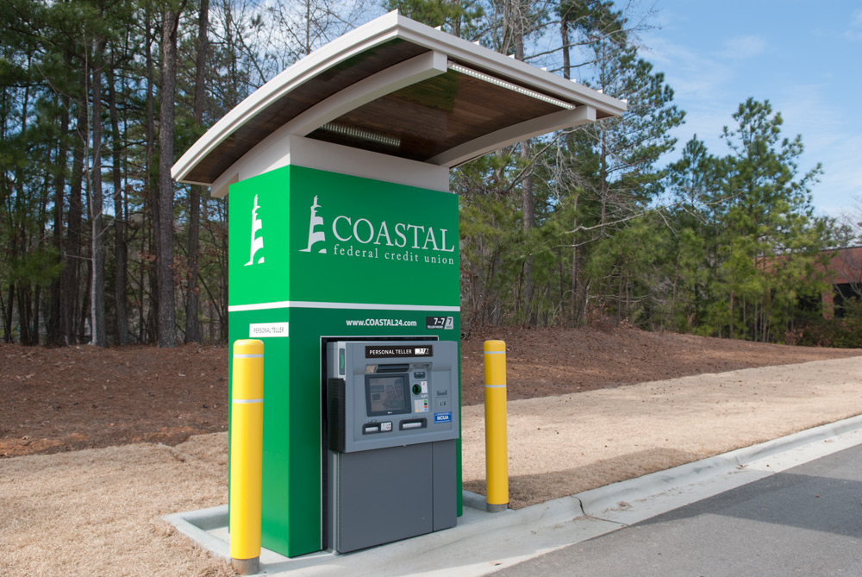
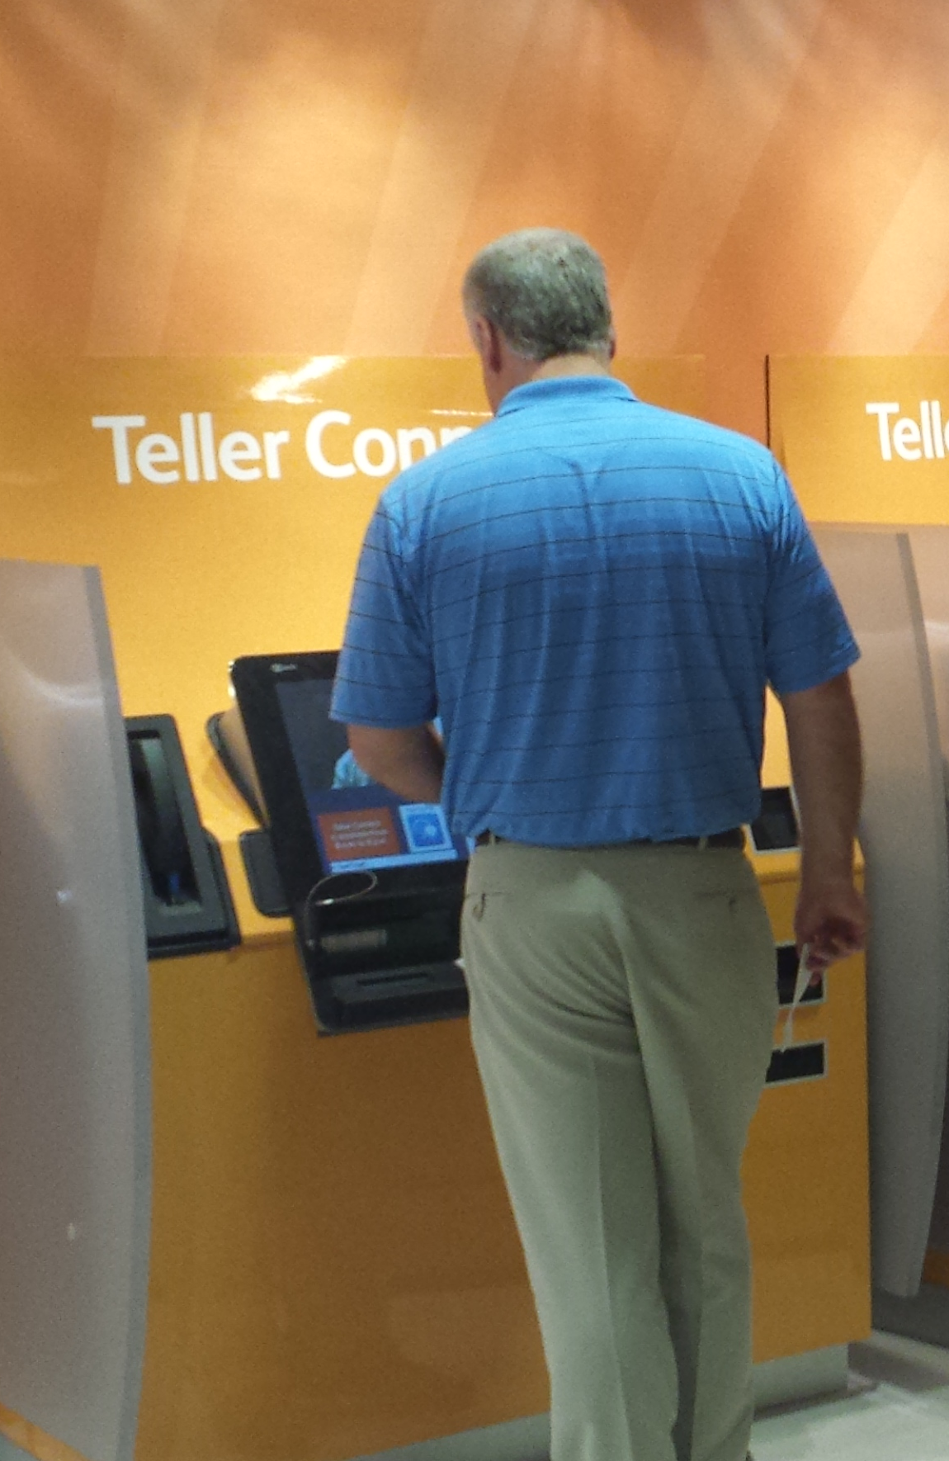
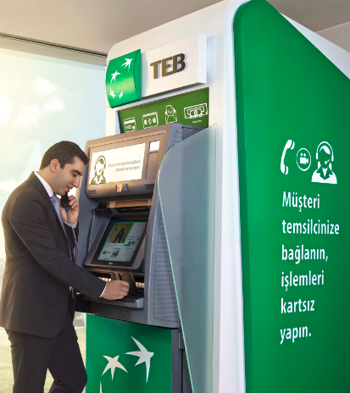
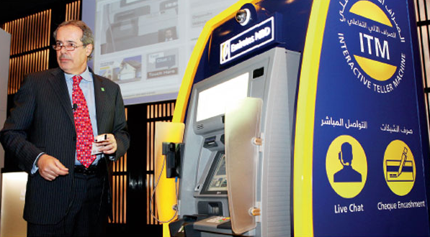
NCR Snapshot - Global Leader in Interactive Services
~350 Interactive Services Customers
70% Beyond Pilot Phase
20+ Global
Enterprise Accounts
Over 100 New North America Interactive Teller Clients In 2016
Notes:
We are transforming how Retail Banking Institutions deliver profitable, sustainable, Human to Human interaction across their omni channel - enabling new lean cost branch formats, re-distributed branch networks & revenue growth

Slide 12
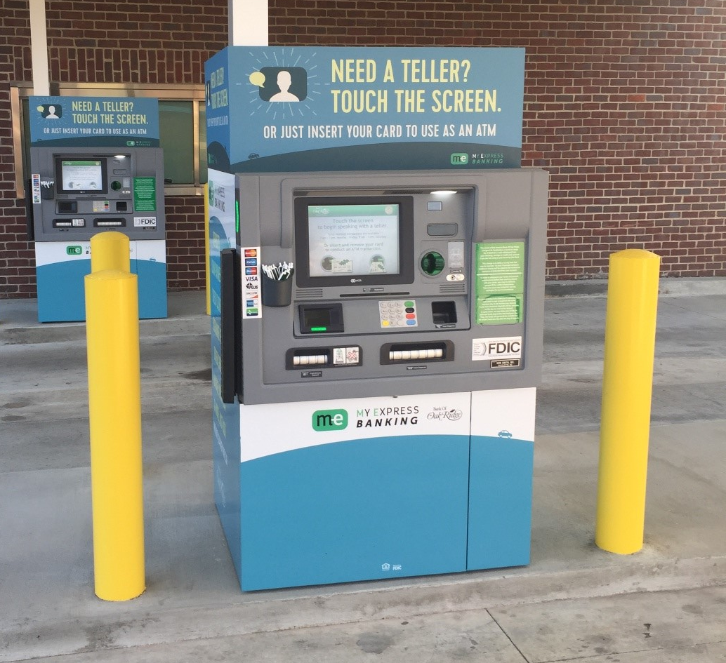
Providing Extended Service for Rural Customers
Service Expansion
Bank of Oak Ridge
New hours 7am-7pm, Mon-Sat
  31% more access for their customers
4 branches, 2 ITMs in every drive-up
  Removed tubes and deal drawer
45 day roll-out of all terminals
Cost effective expansion into new markets
Work/life balance for employees
  Technology allows for flex scheduling
  Used to required all branch staff to work 2-3 Saturdays a month. Now only 1 Saturday required.

Slide 13
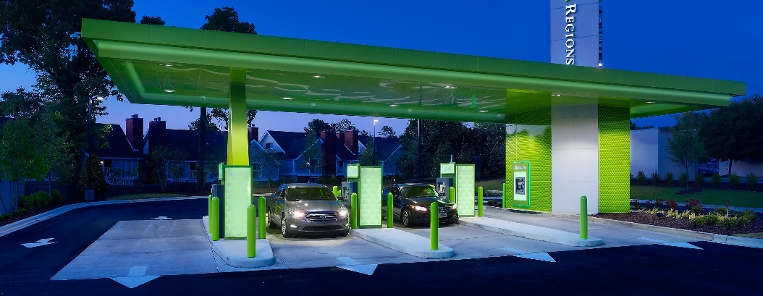
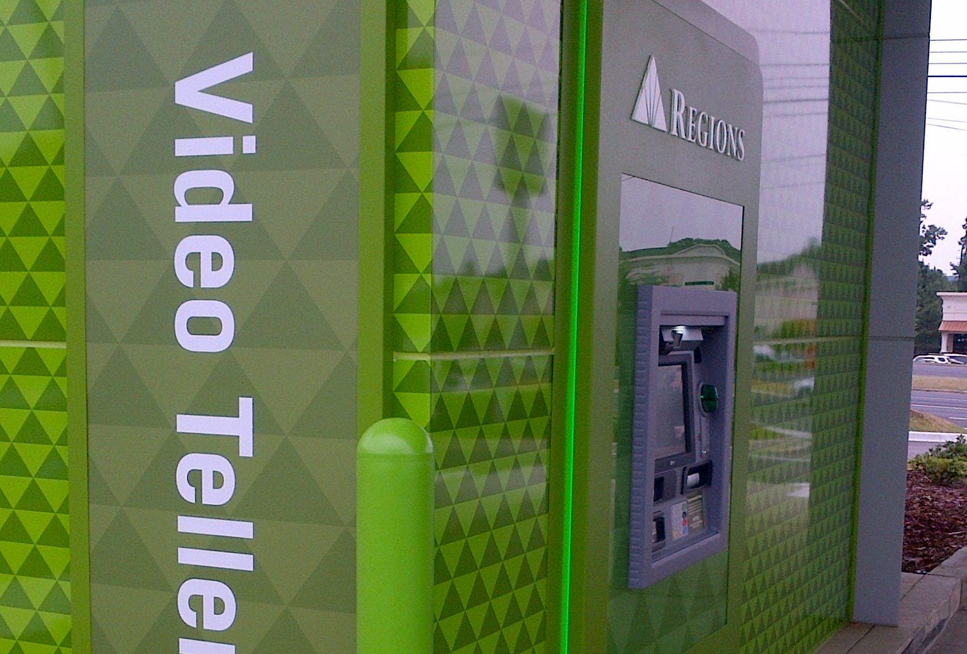
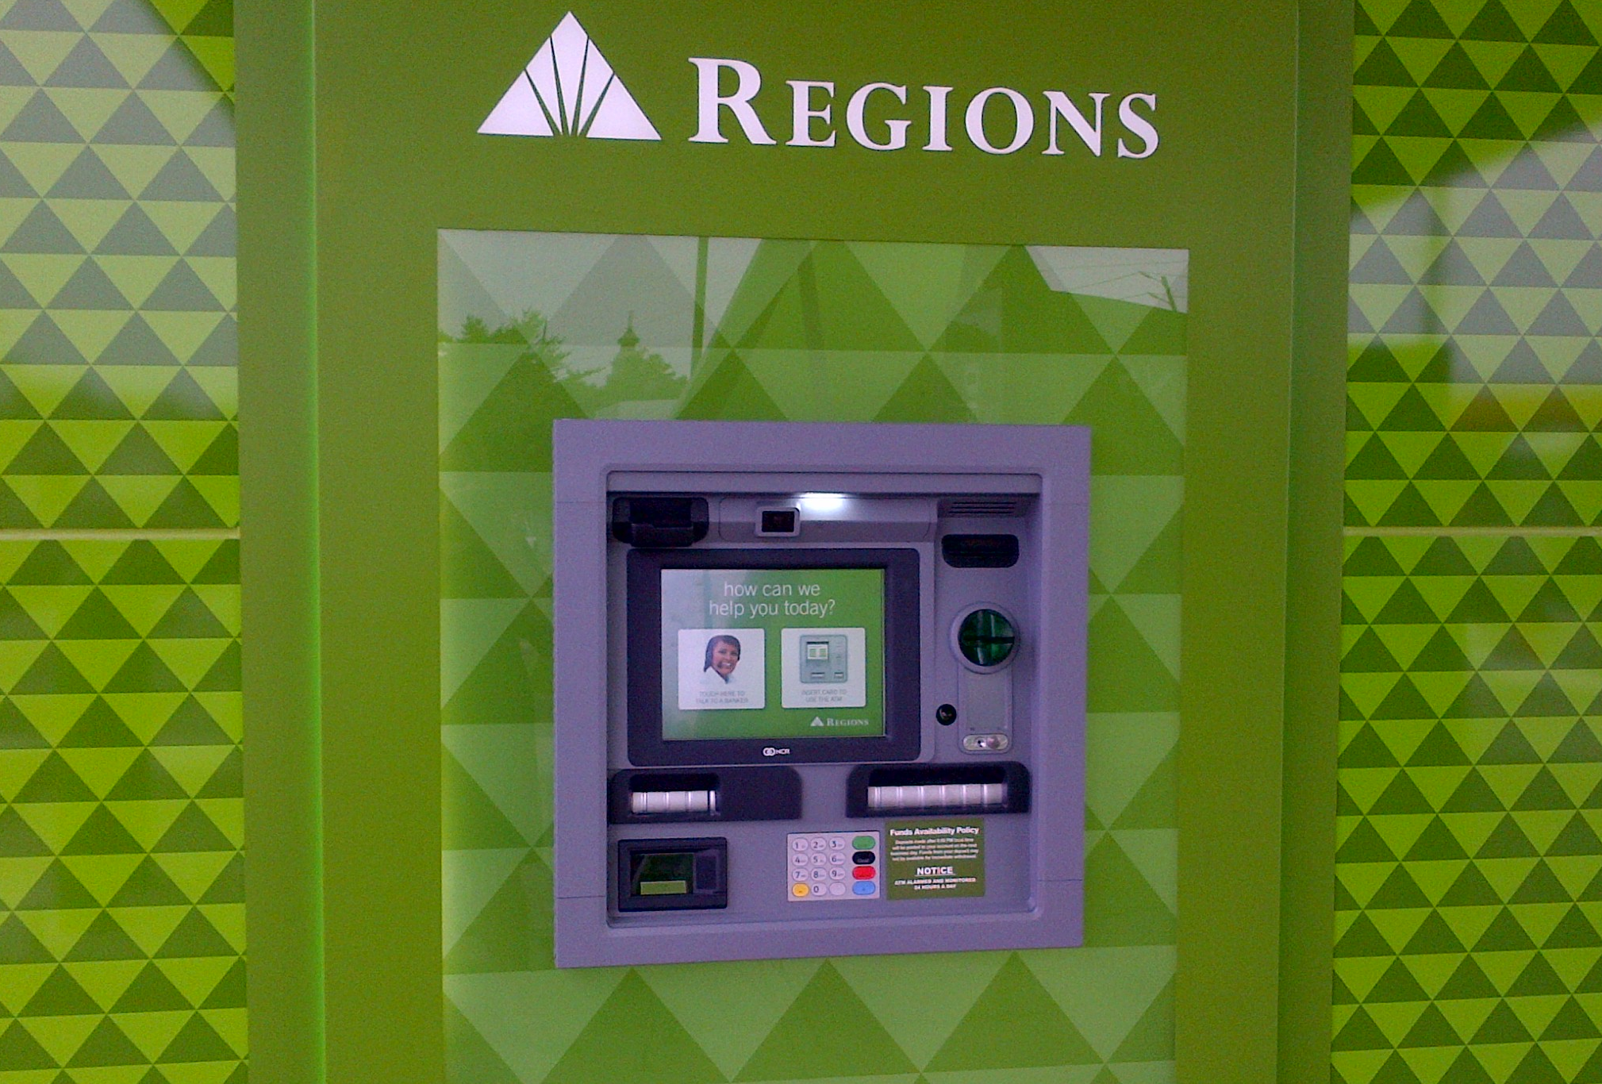
Low cost branch alternative, differentiated customer experience
Regions Bank
Extending daily hours, and now serving customers 7 days a week
Offers consumers the ability to self select based on individual needs
Full function ATM after interactive teller call center hours
Leverage capabilities in existing & new branches

Slide 14
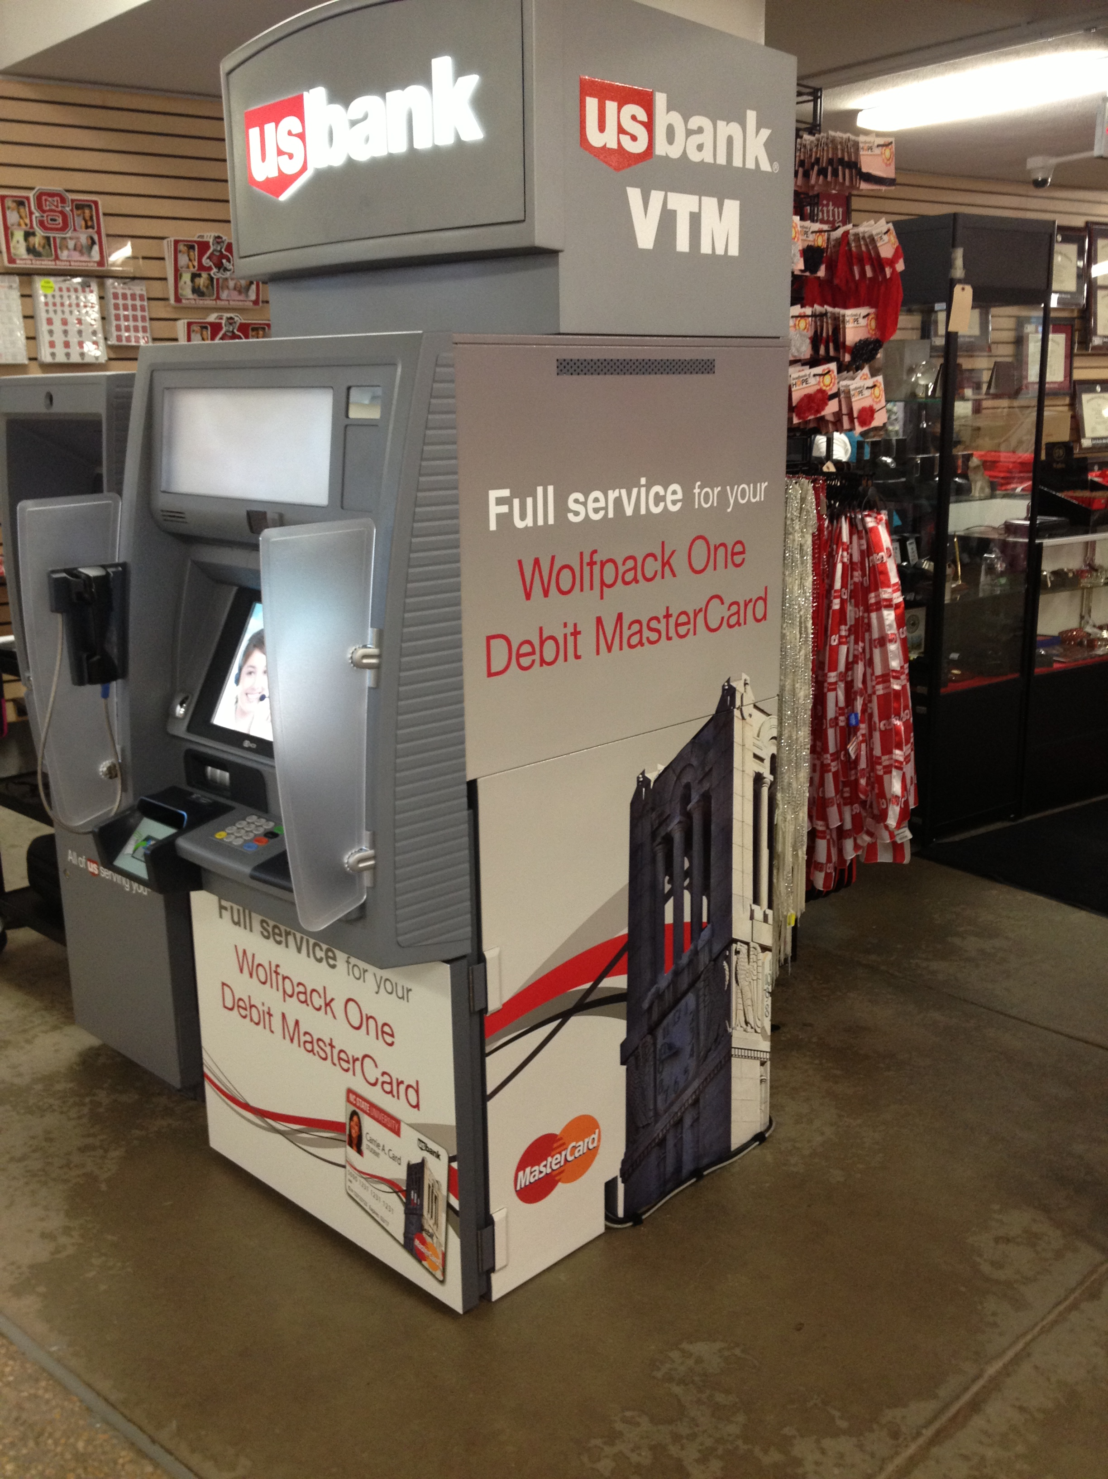
Low cost branch alterative to expand footprint, drive sales
US Bank on NC State Campus
Expanding service delivery footprint to new markets
Eliminating traditional building and staffing costs
Increasing brand penetration to non-traditional locations
Offering extended banking hours as a competitive differentiator
NC State University
NCR Confidential

Slide 15
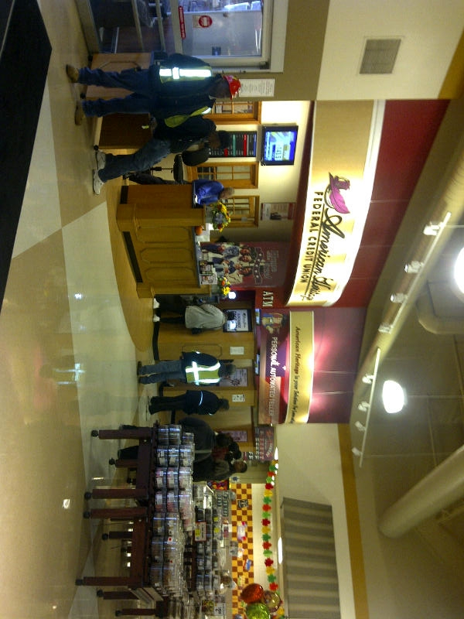
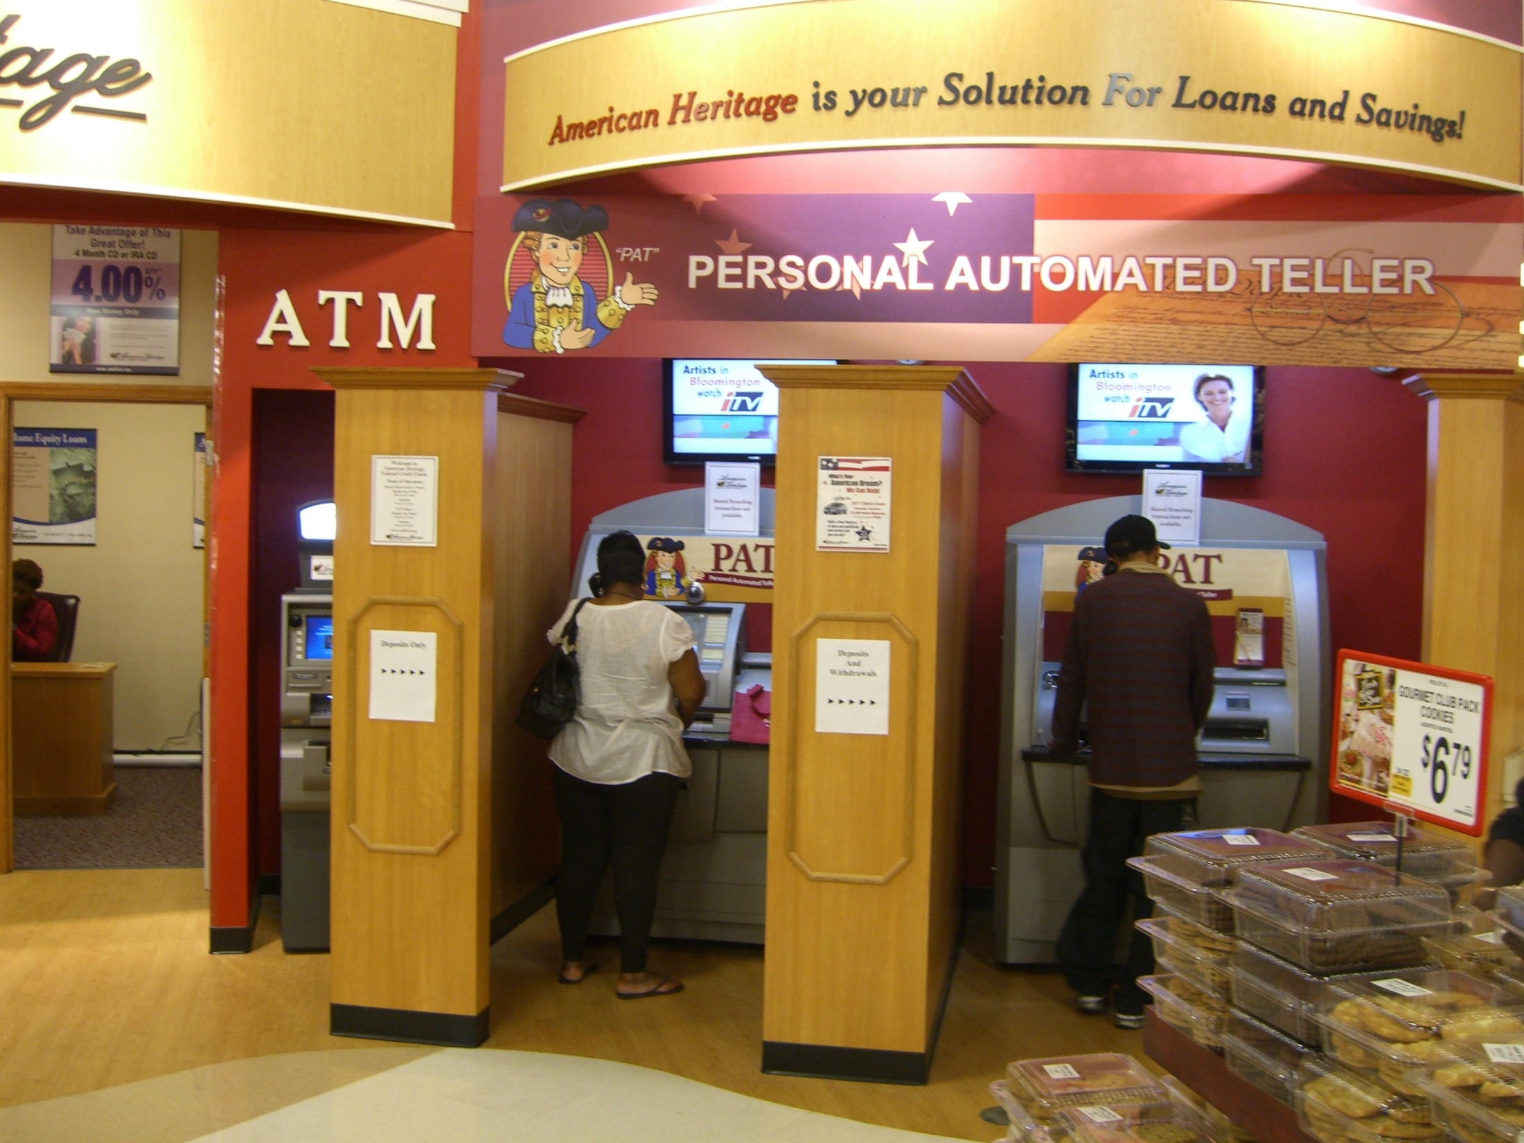
Enhancing Consumer Experience and Growing Existing Market
Expanding Network Distribution and Enhancing Service
American Heritage CU
Grocery Store Deployment
Extended Hours with 2 FTE
Serve under banked market
Appears to be cashless branch –more secure
NCR Confidential

Slide 16
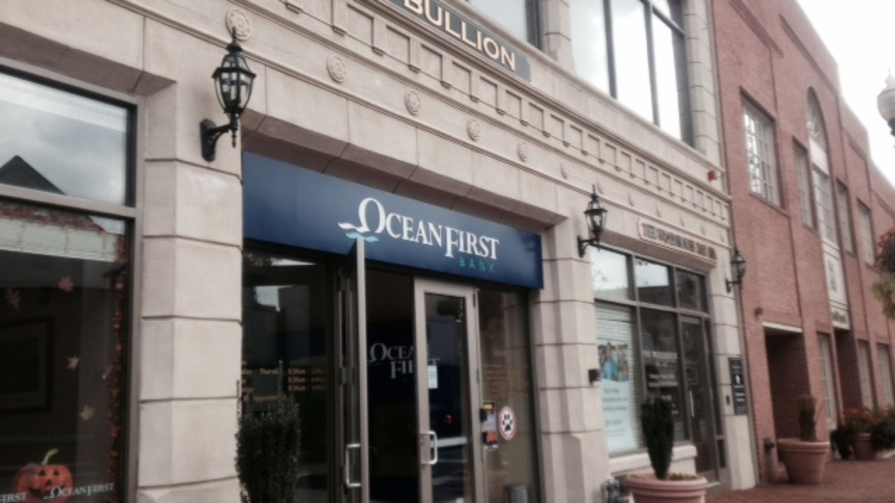
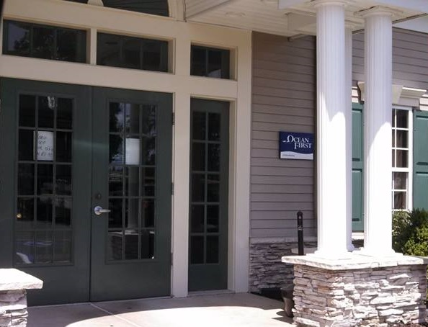
Closing Branch, Leave Behind Strategy, Branch Alternative
OceansFirst Bank
During an acquisition, faced the difficult challenge of reducing an underperforming branch
Location was placed in a retirement community, serving an important customer base
Extended hours
Have seen transaction volumes rise
Shorter wait times, longer hours, and better quality tellers have seen an increase in customer satisfaction scores
NCR Confidential

Slide 17
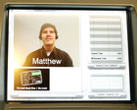

Expanding Service Distribution Model and Growing Market Share
Tellerless Branches, Expanding Service
Coastal Federal Credit Union
Completion of a cashless branch network
100% customer migration across demographics and income brackets
Extension of hours by 86%
41% reduction in teller workforce salary costs
60% rise in branch based sales, as a result of newly sales and service only branches
Tellers now generate new leads at an average rate of 30+ a month/teller
NCR Confidential
17
Notes:
17

Slide 18

Thank you.

