Slide 1

Recent Changes in Bank Branch Prevalence and Current Household Reliance
Keith Ernst
The Future of Banking in
Rural North Carolina
February 15, 2017
Raleigh, NC

Slide 2

Overview
While still high by historical standards, the number of bank branches has been declining over the past five years
These changes have been more pronounced in North Carolina and more still in non-metropolitan areas within North Carolina
Even as digital banking grows, a substantial share of consumers continue to rely primarily on bank branches for account access

Slide 3
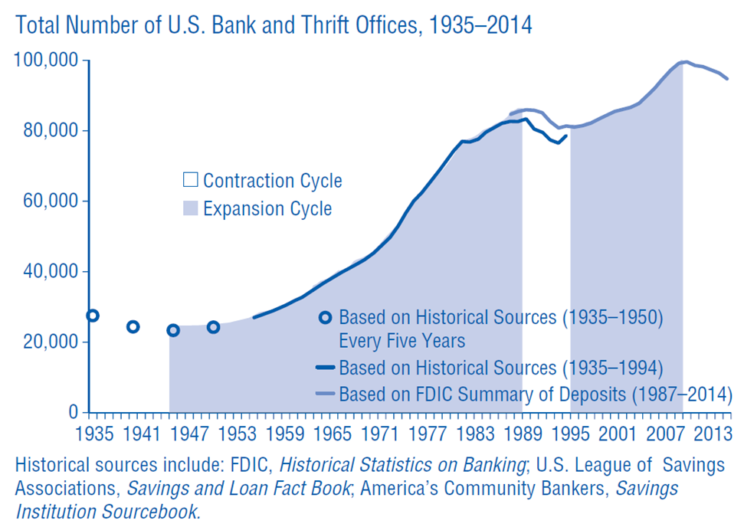
Long Term U.S. Branch Trends

Slide 4
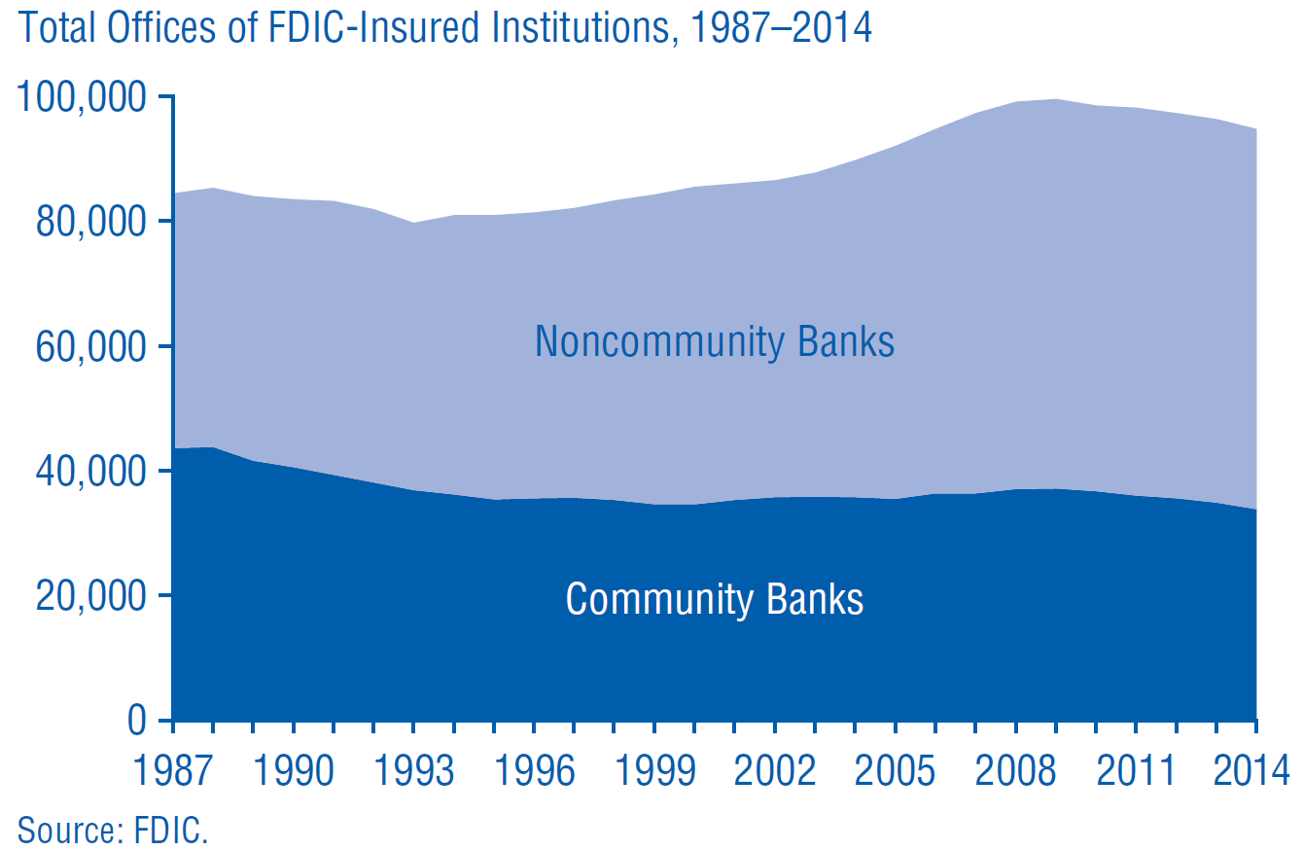
Recent Changes by Community Bank Status

Slide 5
Annual Net Change in Bank Branches (%)

Slide 6
U.S. Branch Annual Changes (Count)

Slide 7
North Carolina Branch Annual Changes (Count)

Slide 8
Net Changes in Branches (%), 2010 - 2015

Slide 9
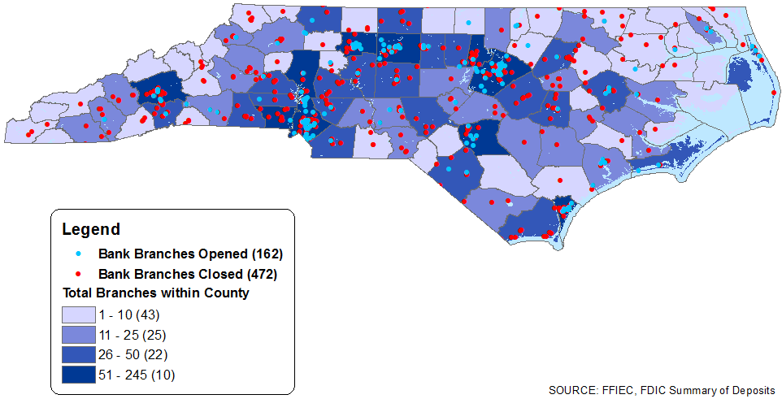
Location of Branch Changes, 2011 - 2015

Slide 10
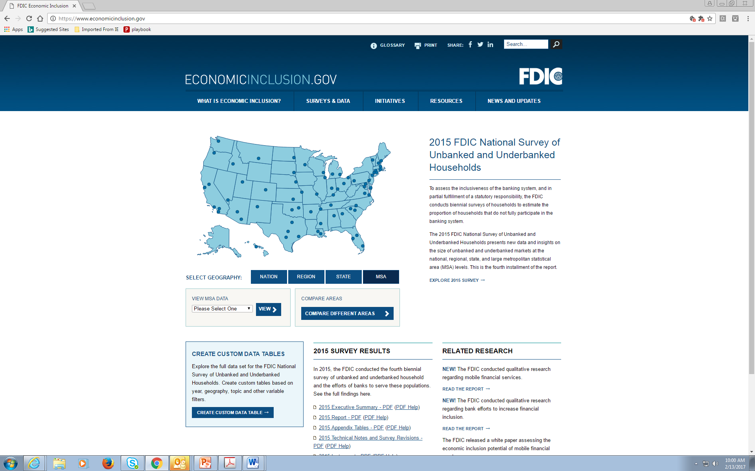
Consumer Reliance on Branches

Slide 11
Account Access: North Carolina (% Hhd)

Slide 12
Primary Account Access: N.C. (% Hhd)

Slide 13
N.C. “Branch Primary” Households by Income

Slide 14
N.C. “Branch Primary” Households by Race

Slide 15
N.C. “Branch Primary” Households by Education

Slide 16
N.C. “Branch Primary” Households by Age

Slide 17
Select Research into Effects of Branches
From 2008-2015, ‘community banks have proportionately opened more offices and closed fewer offices than noncommunity banks’ but total community bank offices experienced a greater decline due to merger, failure, and other activity. (Breitenstein and McGee 2015)
While average distance between small businesses and their financial service suppliers has increased, most relationships remain local with a median distance of five miles as of 2003. (Brevoort and Wolken 2008)
Greater distance contributes to greater loan defaults in small business loans, suggesting that distance interferes with information gathering and monitoring. (DeYoung, Glennon, Nigro 2006)
Proximity to physical branch locations enhances creditworthy LMI borrowers’ ability to obtain loans, and is associated with lower default rates. (Ergungor and Moulton 2012)
Communities with branches see consumers access credit at younger ages, increased account ownership, and achieve better long-run financial health. (Brown, Cookson, Heimer 2016)

