Slide 1
Banking in Rural America Consumer Perspectives
Anna Alvarez Boyd
Senior Associate Director
Federal Reserve Board

Slide 2
Community Development, Policy and Research
Working to understand issues that impact underserved communities
Where are the branches?
“Honey, I’m going to stop by the bank.”
Cash is king. Or is it?
Making good on the promise of technology for rural America
The analysis and conclusions set forth in this presentation are those of the speaker and do not indicate concurrence of the Federal Reserve Board, the Federal Reserve Banks, or their staff.

Slide 3
Bank Branches per Capita
Notes:
92% of the rural counties have a lower rate of HMDA Loans per 100 people than the state as a whole and all of the rural counties have a lower rate of Bank Branches per 30 square miles.
As a general rule, due to lower population density, most rural areas will have a higher number of branches per 10,000 people and lower number per 30 square miles than most urban areas.
However we still see that some of North Carolina’s rural counties have a very low number of branches by both criteria.
Such as Caswell, which has only 2 braches serving a population of 23,174 spread out across 425 square miles of land.

Slide 4
Frequency of Banking Institutions
Notes:
The most rural counties of North Carolina have anywhere from 2 to 16 bank branches in them, run by 2 to 9 unique institutions.
However, while 8% of Banking institutions and 0.9% of bank branches operating in North Carolina are minority institutions, none of these institutions are located in the most rural counties of the state.

Slide 5
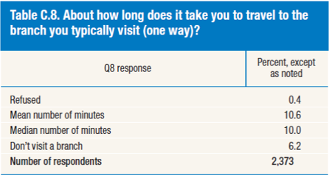
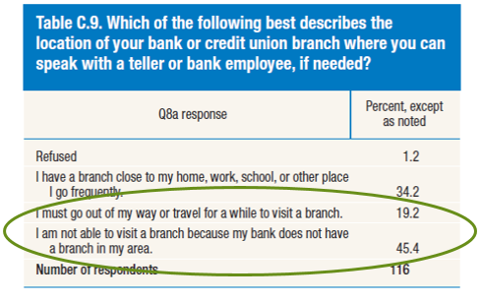
“Honey, I’m going to stop by the bank.”
Notes:
(Left: Table C.8) In the 2015 Mobile Survey, respondents with a bank account were asked about their travel time to the bank branch they typically visit.
For the average respondent, bank branches appear to be relatively accessible, as the mean and median reported travel times were around 10 minutes.
(Transition) About 6 percent of those with a bank account responded that they “don’t visit a branch”
(Right: Table C.9) This smaller group of respondents was asked a follow up question to find out how accessible a bank branch would be if they needed to visit one. The responses (for the little over a hundred respondents in this group) are reported in the table on the right.
Just over a third (34 percent) of those in this group indicated they had a branch close to where they lived or worked, or places they went frequently.
But the majority of those who said they don’t visit a branch indicated there was some level of inconvenience associated with getting to one: 19 percent said they had to go out of their way and 45 percent said they did not have one in their area.

Slide 6
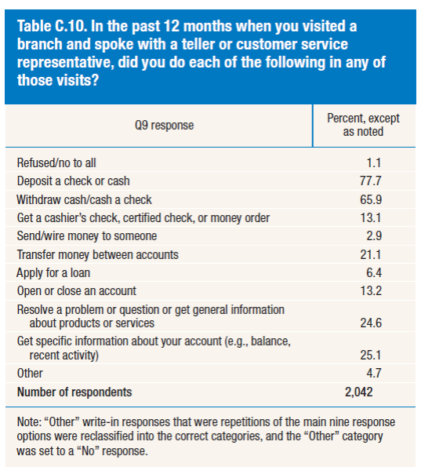
“Honey, I’m still going to stop by the bank.”
Notes:
To better understand how consumers are using branches, the 2015 Mobile Survey also included a question about banking activities consumers may have used a branch for. (Respondents could choose all options that applied.)
Among those who had used a branch in the past year:
The most common activities were depositing a check or cash (78 percent) and withdrawing cash or cashing a check (66 percent).
Resolving problems/questions (25 percent) and getting specific account information (25 percent) were also common answers.

Slide 7
Cash is king. Or is it?
FedCash® Services
The Diary of Consumer Payment Choice
Cash
continues to be the most frequently used consumer payment instrument
is widely used in a variety of circumstances
dominates small-value transactions
The average value of cash holdings has grown
Notes:
As the nation’s central bank, the Federal Reserve ensures that cash is available when and where it is needed, including in times of crisis and business disruption, by providing FedCash® Services to depository institutions and, through them, to the general public. In fulfilling this role, the Fed’s primary responsibility is to maintain public confidence in the integrity and availability of U.S. currency.
The Federal Reserve System’s Cash Product Office (CPO) provides strategic leadership for this key function by formulating and implementing service level policies, operational guidance, and technology strategies for U.S. currency and coin services provided by Federal Reserve Banks nationally and internationally. In addition to guiding policies and procedures, the CPO establishes budget guidance for FedCash® Services, provides support for Federal Reserve currency and coin inventory management, and supports business continuity planning at the supply chain level. It also conducts market research and works directly with financial institutions and retailers to analyze trends in cash use.
The Diary of Consumer Payment Choice is a survey designed to study the purchase and payment behavior of U.S. consumers. The study is conducted using a nationally representative sample of U.S. consumers. The second fielding of the Diary of Consumer Payment Choice (Diary) took place from October 16 to December 15, 2015. Participants were asked to record information on all transactions—purchases, bill payments, deposits, withdrawals, etc.—conducted during an assigned consecutive three-day period.
The 2015 Diary is the second iteration of a research initiative by the Federal Reserve Banks of Boston, Richmond, and San Francisco. The initial Diary, conducted in 2012, found that cash was a valuable payment instrument for a significant portion of consumers and businesses. In the 2012 study, consumers used cash more frequently than any other payment instrument, and cash played a dominant role for small-value transactions and for key demographic groups like lower-income consumers.

Slide 8
Cash is king. Or is it?
Cash is facing competition from other payment instruments.
Income has a strong influence on payment preference but not on cash use.
48%
Consumer use of debit and credit cards account for 48 percent of all reported transactions in the 2015 data.
Notes:
The 2015 results also show that cash is facing competition from other payment instruments. In 2015, 32 percent of consumer transactions were made with cash, compared with 40 percent in 2012. Growing consumer comfort with payment cards and the growth of online commerce, among other factors, contribute to this trend. Nonetheless, a broad range of results suggests that cash remains resilient and continues to play a key and unique role for consumers.
Despite innovations in smartphone technology and mobile payment apps, Fed data on the amount of currency in circulation suggest that demand for cash is strong. Figure 1 shows currency in circulation from January 1980 to August 2016 and includes notes held by merchants, financial institutions, and consumers. The amount of currency in circulation has increased steadily over time, and demand for higher denominations has accelerated in the years since the 2008 financial crisis.
Households earning less than $25,000 annually have a particularly strong cash preference, with 48 percent preferring cash, down from 55 percent in the 2012 Diary. Households earning greater than $75,000 annually saw a two to three percentage point increase in cash preference, though households earning $150,000 and greater continued to exhibit the smallest cash preference at 14 percent.

Slide 9
Making Good on the Promise of Technology for Rural America
Mobile banking usage in non-metro areas:
33% of residents used mobile banking
17% used mobile payments
Notes:
Thirty-three percent of residents in non-metropolitan (non-metro) areas reported using mobile banking services in the prior twelve months compared with 39 percent of respondents in metropolitan (metro) areas. Similarly, a smaller percentage (17 percent) of non-metro respondents reported using mobile payments in the prior twelve months relative to respondents in metro areas (23 percent).
Overall, respondents from non-metro areas are as likely to be “banked” as metro area respondents—86 versus 87 percent, respectively—but somewhat less likely to use either mobile banking services or mobile payments. The lower usages may be associated with lower availability of or consumers’ knowledge about mobile banking services by their financial institution, lower levels of smartphone adoption, and less continuous mobile broadband access. They could also be attributed to other factors, including differences between urban and rural residents in preferences, demographic characteristics, or demand for these services. These results indicate that the promise of mobile technology as a way to bridge some challenges of living in rural areas may have not yet been fully realized.

Slide 10
Making Good on the Promise of Technology for Rural America
84% own a mobile phone
Just 54% own a smartphone
57% report access to a wireless network is “nearly always available”
Notes:
Non-metro residents are slightly less likely than metro residents—84 versus 88 percent—to own a mobile phone, but considerably less likely to own a smartphone—54 versus 63 percent. They are also less likely to report near-constant access. When asked to characterize their Internet access on a mobile phone through wifi or a wireless network, 57 percent of non-metro respondents described it as “nearly always available,” compared to 64 percent of respondents in metro areas (table A).2 This relative lack of smartphone ownership and constant mobile Internet access may make use of certain mobile services less attractive or perhaps not possible.

Slide 11
Making Good on the Promise of Technology for Rural America
Is mobile banking offered by your financial institution?
65% said yes compared to 75% in metro areas
30% report not knowing if mobile banking was offered compared to 21% in metro areas
Notes:
When it comes to mobile banking, the supply of services also appears to differ. When asked whether mobile banking was offered by their financial institution, 65 percent of respondents in non-metro areas said yes, compared to 75 percent in metro areas (figure B). A higher share (30 percent) of respondents in non-metro areas also reported not knowing if mobile banking was offered by their financial institution, compared to 21 percent in urban areas. Whether this represents a lack of interest by rural consumers or simply a lack of awareness, it would seem that fewer rural residents have access to mobile banking or are aware of available mobile banking services relative to residents of more urban areas.

Slide 12
Branch Closures and Lending to the Smallest Small Businesses
Is there still a place for relationship banking for the smallest small businesses?
Larger banks account for a growing share of small business loans.
Perhaps no:
Small business loans – particularly small dollar loans below $250,000 – cost the same to underwrite as larger loans;
Larger banks can use automated underwriting for business credit cards and lines of credit;
Online alternative lenders are expanding access to small-dollar loans
Perhaps yes:
Banks with <$10B in assets still account for a disproportionate high, though shrinking, share of small business lending;
Small businesses say their banks are a trusted source of advice;
Research has shown community banks’ lending is more likely to remain fairly steady during a recession
Note: Chart provided by Jagtiani and adapted from Jagtiani and Lemieux (2016)

